Slide 1
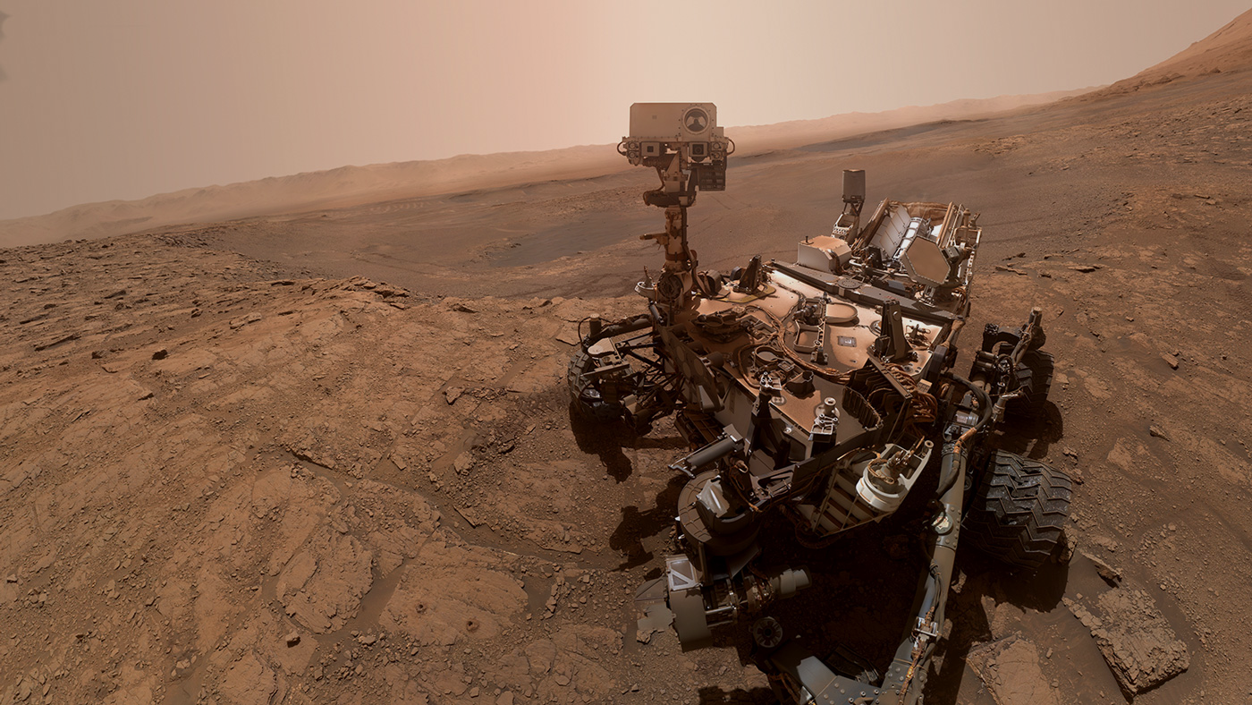




ArtemiS3
An intelligent search tool for AWS S3 buckets.
Sponsored by: Trent Hare. USGS Cartographer.
1

Slide 2


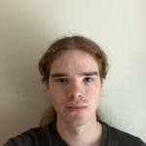

ArtemiS3
Meet the Team
2
Jeffrey Hoelzel Jr
Architect
jmh2338@nau.edu
Joseph Laity
Team Lead
jbl265@nau.edu
Samuel Bodenheimer
Release Manager
swb79@nau.edu
Travian Lenox
Software Lead
tjl379@nau.edu
Our CS capstone mentor is Md Nazmul Hossain.

Slide 3


ArtemiS3
Meet Our Client
3
Trent Hare. USGS Cartographer. Supporting NASA’s Planetary Data System.
USGS uses Amazon Web Services (AWS) Simple Storage Service (S3) for cloud storage.
NASA’s planetary datasets are massive taking researchers many minutes or longer to search through.

Slide 4



ArtemiS3
Current Example Workflow
Step 1
Step 2
Step 3
4
NASA missions collect data.
USGS archives data in AWS S3 buckets.
A user accesses mission data via a simple S3 browser.

Slide 5





ArtemiS3
Problem Statement
5
The problem
Researchers must navigate massive S3 data stores manually with a simple file browser which is time consuming, brittle, and error prone.
Specific limitations
No full-text search
No metadata or keyword search
No global filtering or sorting
No file previews or summaries
No collaboration tools
No geospatial visualization
No integrated security configuration

Slide 6


ArtemiS3
Solution Overview
6
Makes NASA’s planetary data in AWS S3 searchable, visual, and secure.
Enables fast exploration
Search, filters, and dashboards.
Instant results and metadata previews
Key Features
Full-text and metadata search.
User-friendly dashboard.
Visualization tools.
Tagging and organization.
Automated metadata and text file indexing.

Slide 7

ArtemiS3
Requirements Acquisition
7
Initial meeting.
Overview analysis.
Tech feasibility.
Requirements draft.
Iterate on requirements using client’s feedback.
Finalized initial project requirements. Develop MVP.

Slide 8
ArtemiS3
ArtemiS3’s Conceptual Requirements
8
DR1. Efficient Data Discovery.
DR5. Security and Privacy.
DR2. Intuitive User Experience.
DR6. Open-Source and Reusability.
DR3. Collaboration and Tagging.
DR7. Optional Visualization Features.
DR4. Scalable and Reliable Architecture.

Slide 9
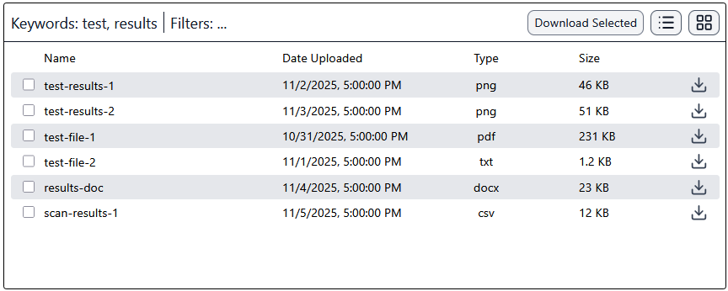
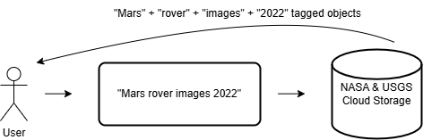
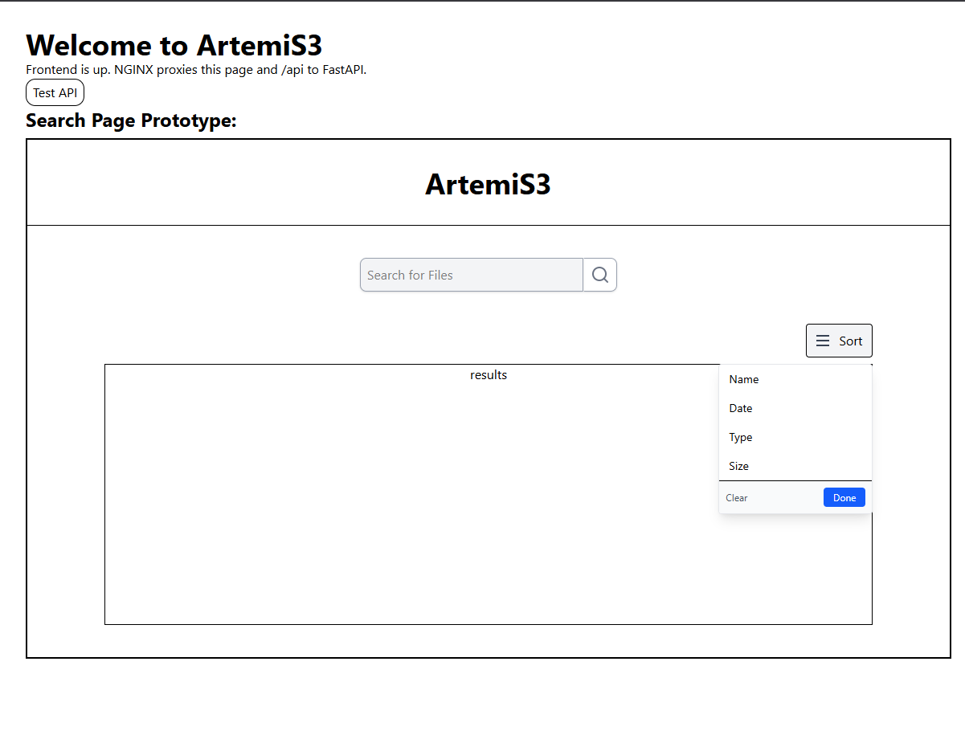
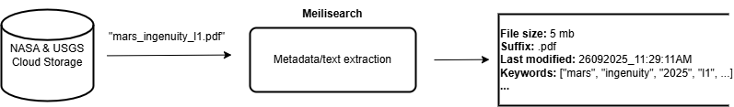
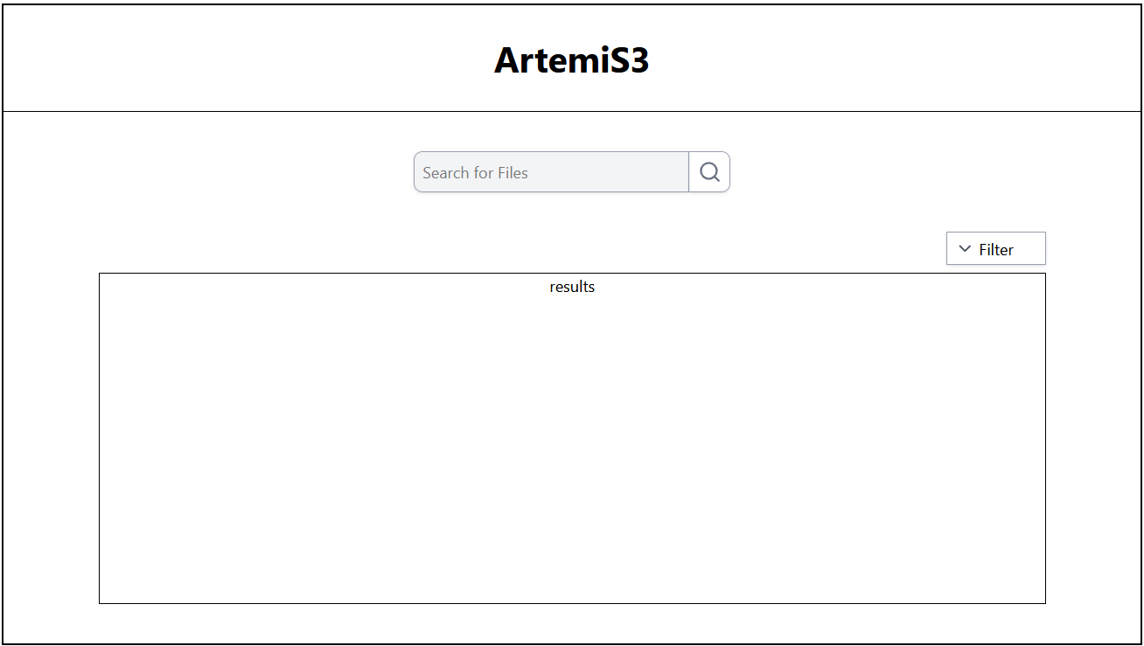
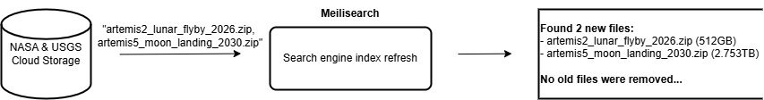
ArtemiS3
The MVP
9
4. Interactive search results.
1. File retrieval from search.
5. Search filtering & sorting.
2. Metadata/text extraction & indexing.
3. Search page.
6. Search engine index refresh.

Slide 10
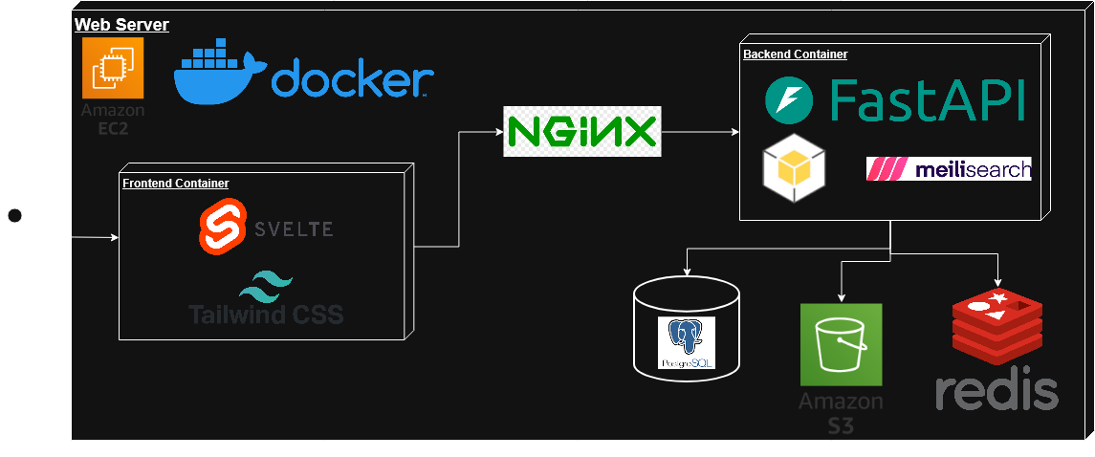
ArtemiS3
Project Feasibility
10
After thorough analysis and prototyping the project’s feasibility, ArtemiS3 will include:
Frontend
Svelte
Tailwind CSS
Backend
FastAPI
Boto3
Meilisearch
Assisting Infrastructure Components
Docker
PostgreSQL
AWS EC2 + S3
Redis

Slide 11
ArtemiS3
Possible Risks
Availability
Result Correctness
Data Loss
11
An AWS outage or automation failure could temporarily make the web application unavailable.
A search engine or response error could potentially return incorrect search results.
If the search index is somehow lost, reindexing could prevent use for several hours.

Slide 12
ArtemiS3
Schedule
12
7
6
Finalize Project, Document, and Present
5
Final Integrations and Optional Features
4
Reliability, Monitoring, and Automated Testing
3
Frontend Interface Development & Visualizations
2
Apr ‘26
Core Backend Development & Search Engine Integration
Mar ‘26
1
Configure Environment
Mar ‘26
Setup, Requirements, and Present Feasibility
Feb ‘26
Jan ‘26
Dec ‘25
Nov ‘25

Slide 13

ArtemiS3
Summary
13
Partnering with USGS & NASA’s Planetary Data System.
Making planetary data searchable, visual, and secure.

Slide 14




Thank you
ArtemiS3
14
Jeffrey Hoelzel Jr
Architect
jmh2338@nau.edu
Joseph Laity
Team Lead
jbl265@nau.edu
Samuel Bodenheimer
Release Manager
swb79@nau.edu
Travian Lenox
Software Lead
tjl379@nau.edu

